Slide 1
Neural Networks for Machine Learning tensorflow playground

Slide 2
TensorFlow Playground
Great javascript app demonstrating many basic neural network concepts (e.g., MLPs)
Doesn’t use TensorFlow software, but a lightweight js library
Runs in a Web browser
See http://playground.tensorflow.org/
Code also available on GitHub
Try the playground exercises in Google’s machine learning crash course

Slide 3
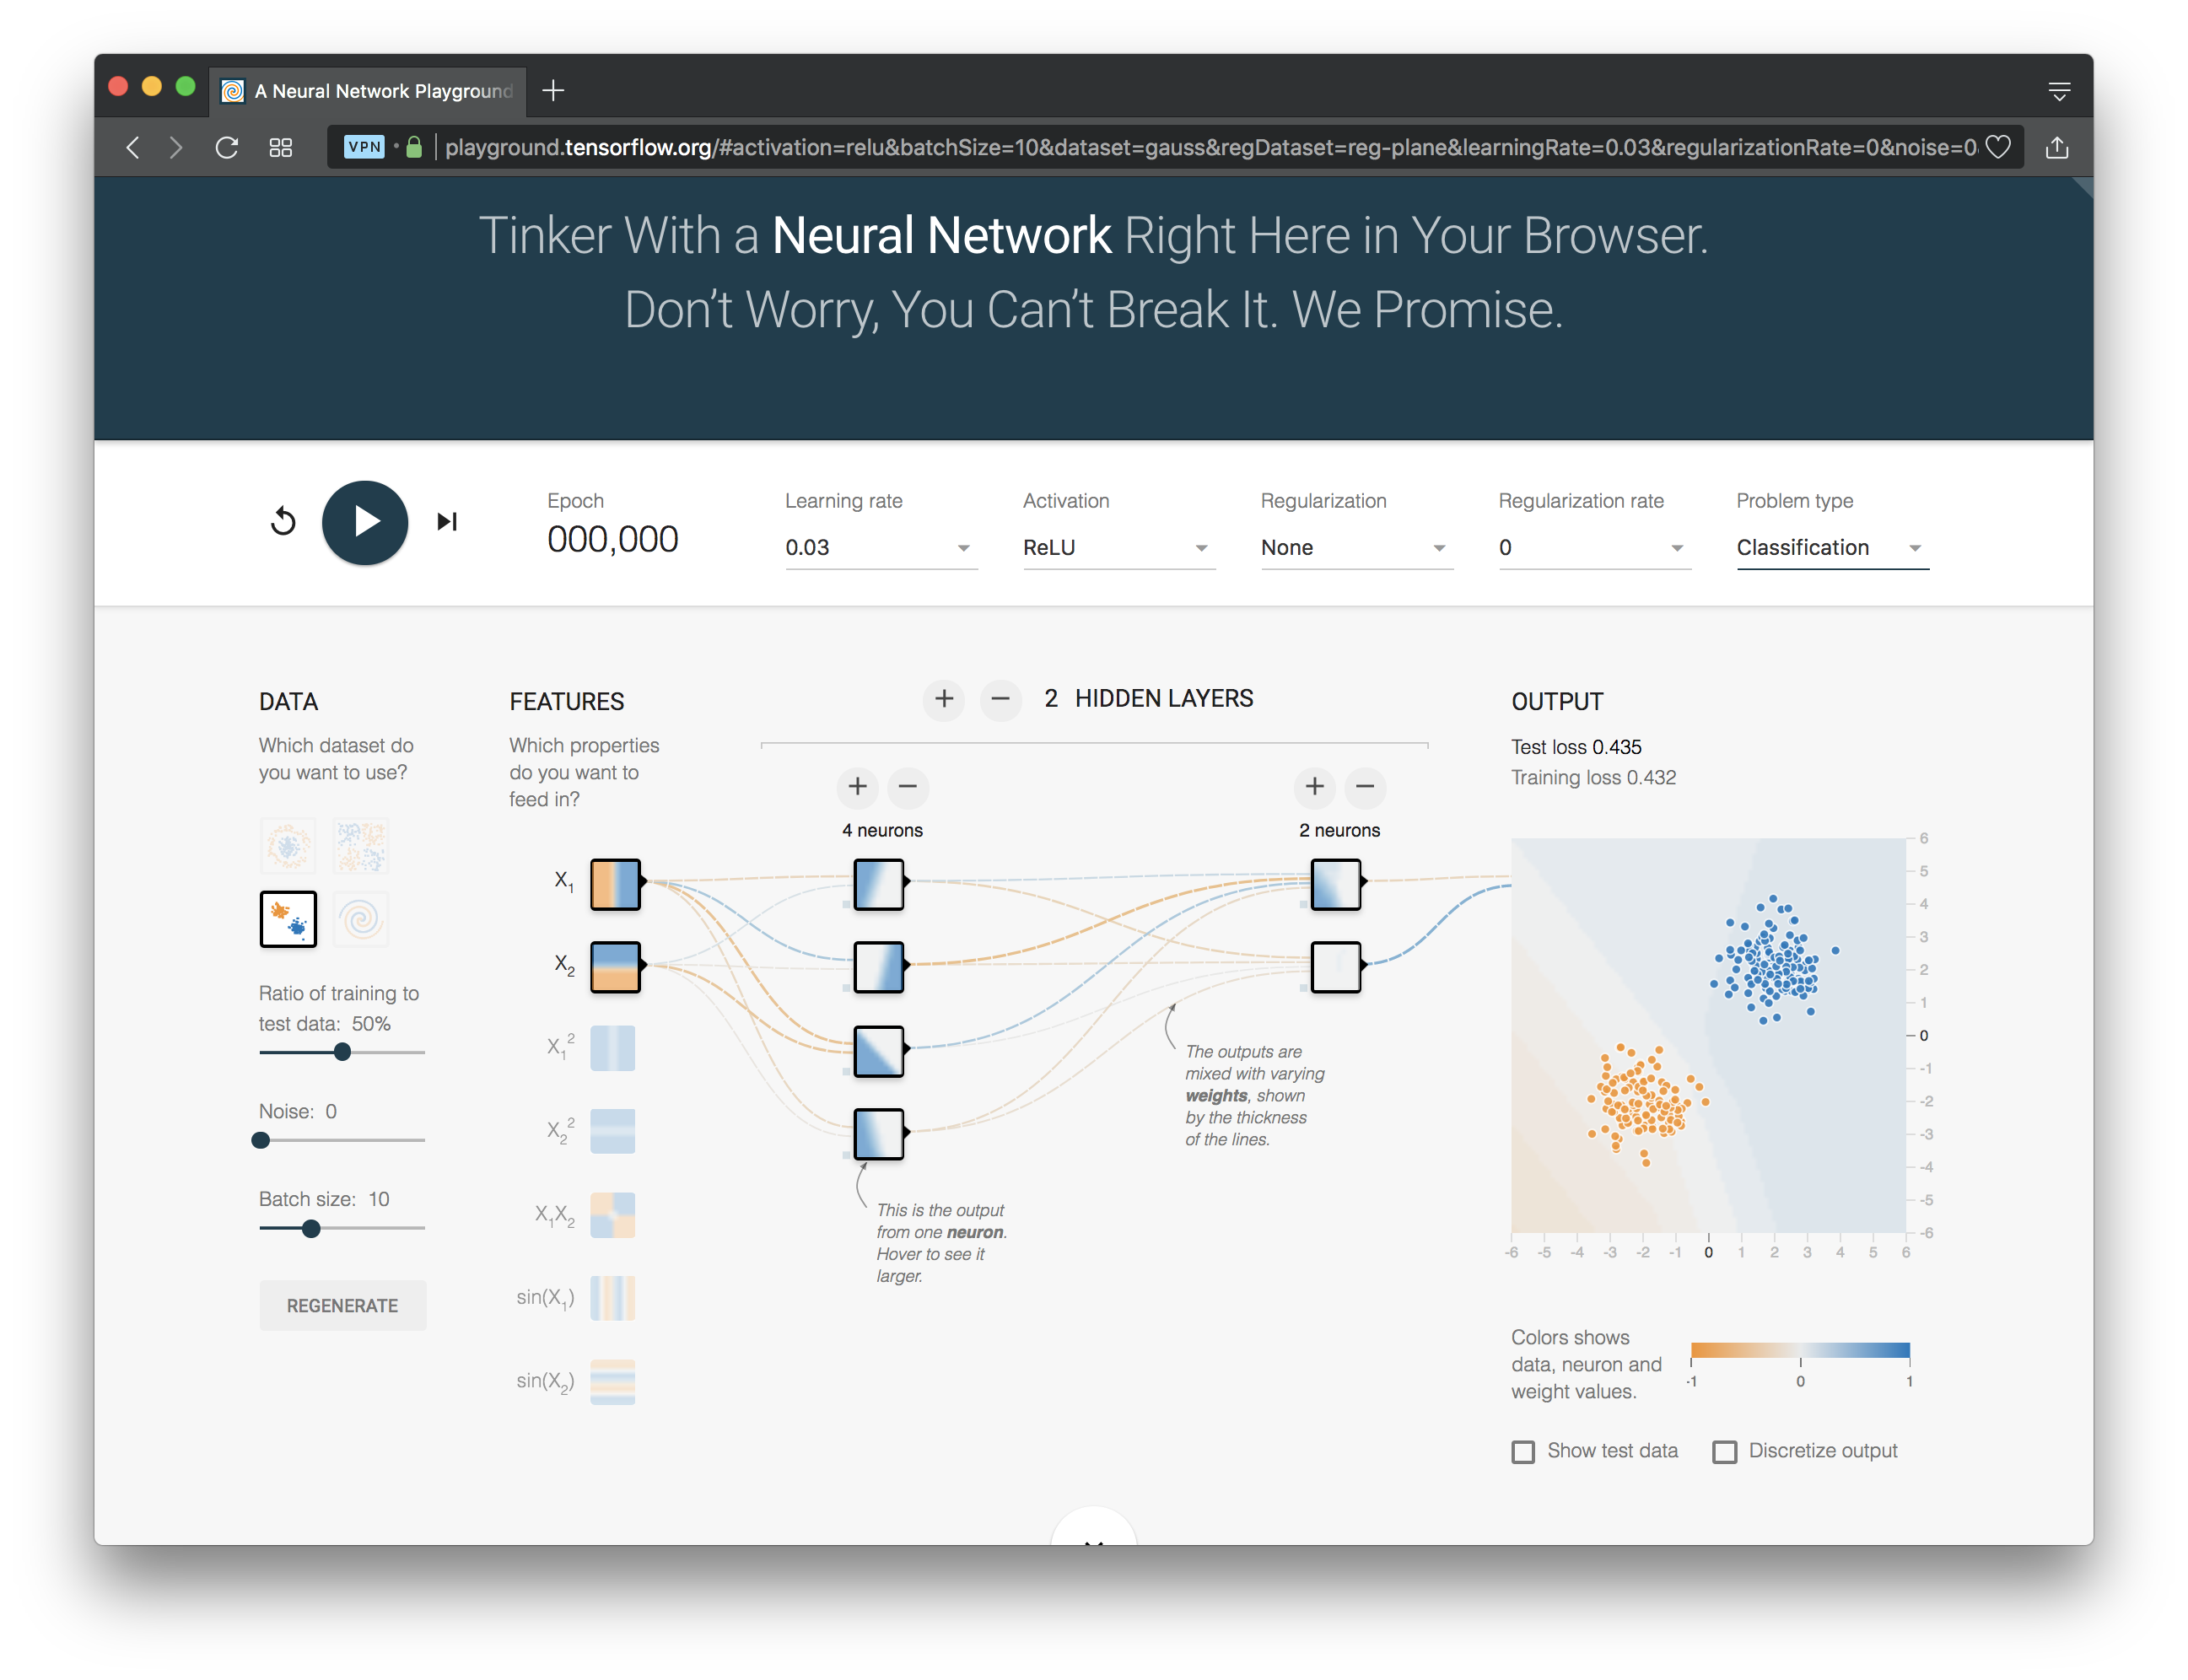
http://playground.tensorflow.org/

Slide 4
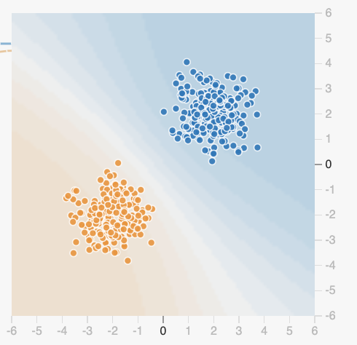
Datasets
Six datasets, each with 500 (x,y) points on a plane where x and y between -5 and +5
Points have labels of positive (orange) or negative (blue)
Two possible machine learning tasks:
Classification: Predict class of test points
Regression: find function to separate classes
Evaluation: split dataset into training and test, e.g., 80% training, 20% test

Slide 5
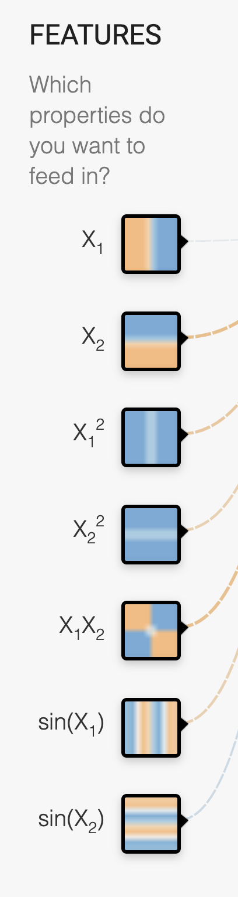
Available Input features
X₁ Point’s x value
X₂ Point’s y value
X₁² Point’s x value squared
X₂² Point’s y value squared
X₁X₂ Product of point’s x & y values
sin(X₁) Sine of point’s x value
sin(X₂) Sine of point’s y value

Slide 6
Designing a neural network
Simple feed forward NNs have a few choices
What input features to use
How many hidden layers and their details:
How many neurons are in each layer
How each layer is connected to ones before & after
Complex NNs have more choices
E.g., CNNs, RNNs, etc.
High-level interfaces (e.g., Keras) try to make this easier

Slide 7
http://playground.tensorflow.org/

Slide 8
Training a Neural Network
Neural networks are used for supervised machine learning and need to be trained
The training process is broken done in a series of epochs
In each epoch, all training data run through the system to adjust the NN parameters
Process ends after a fixed # of epochs or when error rate flattens or starts increasing

Slide 9
Typical Training Flow
Divide training data into batches of instances (e.g., batch size = 10)
For each epoch:
For each batch:
Instances run through network, noting difference between predicted and actual value
Backpropagation used to adjust connection weights
Stop when training loss flatten out
If test loss is too high, then try
Adding additional hidden layers
Adding more features to inputs
Adjusting hyperparameters (e.g., learning rate)
Get more training data

Slide 10
Hyperparameters
Parameters whose values are set before the learning process begins
Basic neural network hyperparameters
Learning rate (e.g., 0.03)
Activation function (e.g., ReLU)
Regularization (e.g., L2)
Regularization rate (e.g., 0.1)

Slide 11
Learning rate
Gradient descent used in backpropagation to adjust weights to minimize the loss function
Learning rate determines how quickly weights are adjusted each time
If too high, we may miss some or most minima
Result: erratic performance or never achieving a low loss
If too low, learning will take longer than necessary

Slide 12
Gradient Descent
Iterative process used in ML to find local minimum in our loss function measuring errors
Moves in direction of steepest descent
Step size decreases as steepness lessens to avoid missing minima
Custom variants for NNs include adam optimization

Slide 13
Activation Function
Determines a node’s output given weighted sum of its inputs
The ReLu (rectified linear unit) is simple and a good choice for most networks
Returns zero for negative values and its input for positive ones
f(x) = max(0,x)

Slide 14
Regularization
Parameter to control overfitting, i.e. when the model does well on training data but poorly on new, unseen data
L2 regularization is the most common
Using dropout is another common way of reducing overfitting in neural networks
At each training stage, some nodes in hidden layer temporarily removed (dropped out)

Slide 15
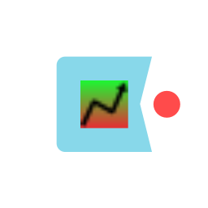
Hyperparameter optimization
How do we find the best settings for these hyperparameters?
Experimentation
Experiment with a range of different settings (e.g., for learning rate) via multiple runs
Use a grid search tool, e.g., scikit learn’s
Experience
Similar problems with similar data will probably benefit from similar settings

Slide 16
http://playground.tensorflow.org/

